Slide 1
CYBERCRIME CELL TO ANALYZE CRIMINAL DATA
K-AKA TECHNOLOGY SERVICES
INTERNAL GUIDE:
DR.K.G.MADHWARAJ,
PROFESSOR,
DEPT OF MCA.
EXTERNAL GUIDE:
ABHINAV KUMAR ABHAY,
SOFTWARE DEVELOPER,
K-AKA TECHNOLOGY SERVICES.

Slide 2
PRESENTATION OUTLINE
About Organization / Company
About department
Task performed
Reflection notes
References

Slide 3
ABOUT ORGANISATION
K-AKA is a fast and growing software company, started in the year 2020 to provide the best services to the users need's.
It is a (SaaS) Software as a service company, currently growing its network in the Bangalore, New-Delhi, etc.
This company focuses on the multiple domain such as :
1)Training
2)Development
3)SaaS (Software as a Services)
4)Consultancy

Slide 4
ABOUT DEPARTMENT
PHASE 1: TRAINING
MACHINE LEARNING USING PYTHON
PHASE 2: DEVELOPMENT
CYBERCRIME CELL TO ANALYZE CRIMINAL DATA

Slide 5
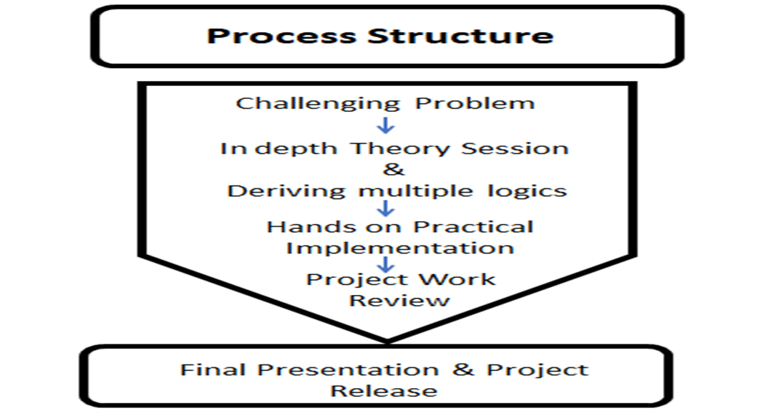
ABOUT DEPARTMENT: Process Structure

Slide 6
TASK PERFORMED
MACHINE LEARNING USING PYTHON
Learnt tkinter framework
Window creation using tkinter
Implementing Firebase Authentication
Generating random password and storing the data in a logfile
Extracting login details
Implementing Firebase storage

Slide 7
Other TASK PERFORMED
Capturing real-time image from camera
Learnt knn algorithm for image processing
Implementation of alerts for face detection
Creating a menu to upload image from local system
Reading the data from a CSV file to analyze (Data analytics)
Implementing graphical data to tkinter window (Data Visualization)

Slide 8
TOOLS USED:
FRONT-END: TKINTER
BACK-END: FIREBASE
LANGUAGE: PYTHON
IDE: SPYDER

Slide 9
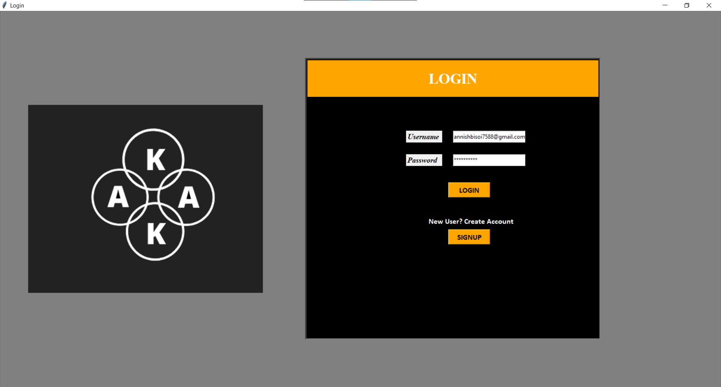
LOGIN

Slide 10
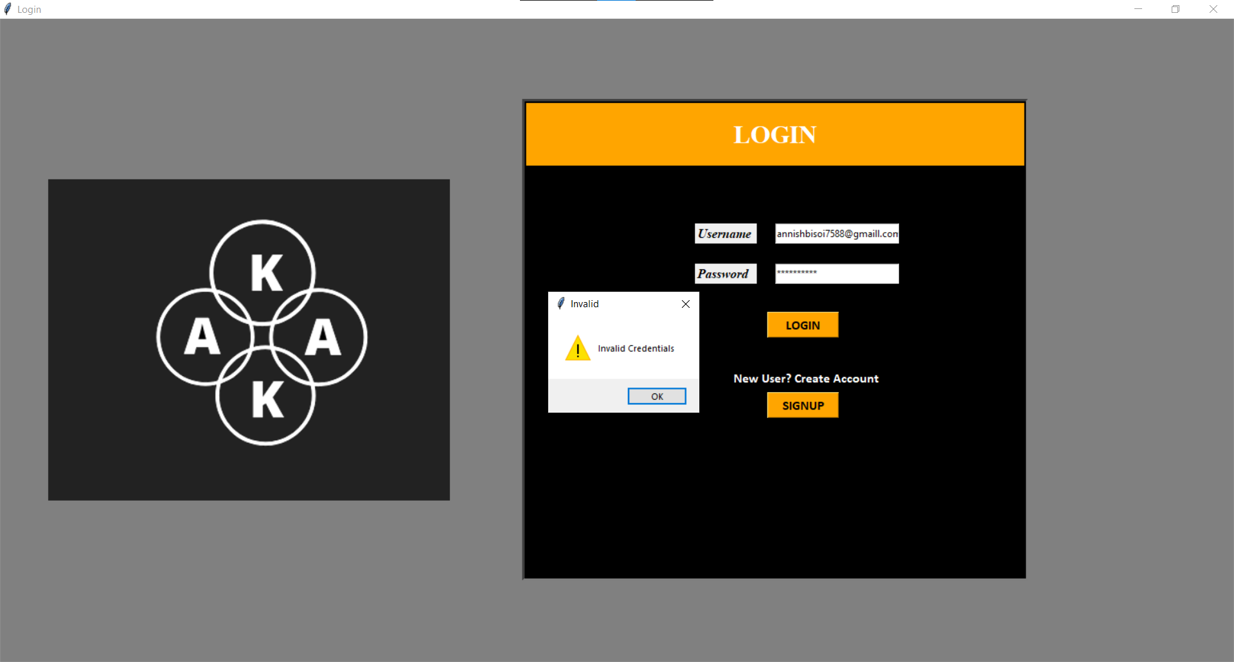
LOGIN WITH INVALID CREDENTIALS

Slide 11
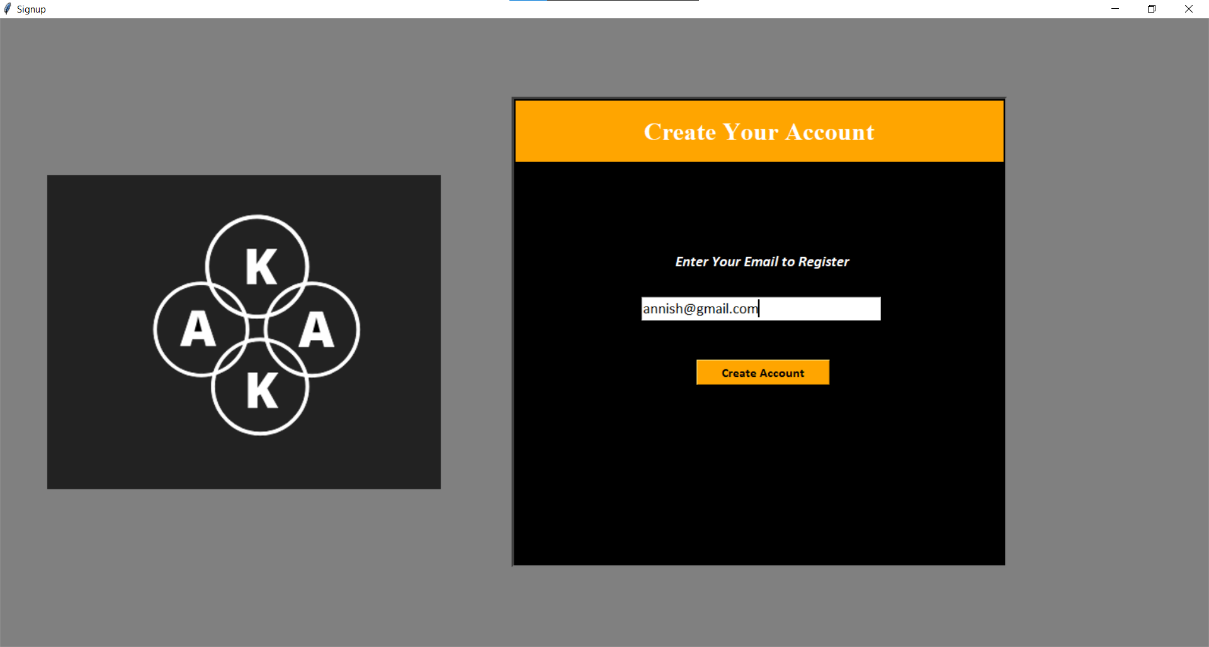
SIGNUP

Slide 12
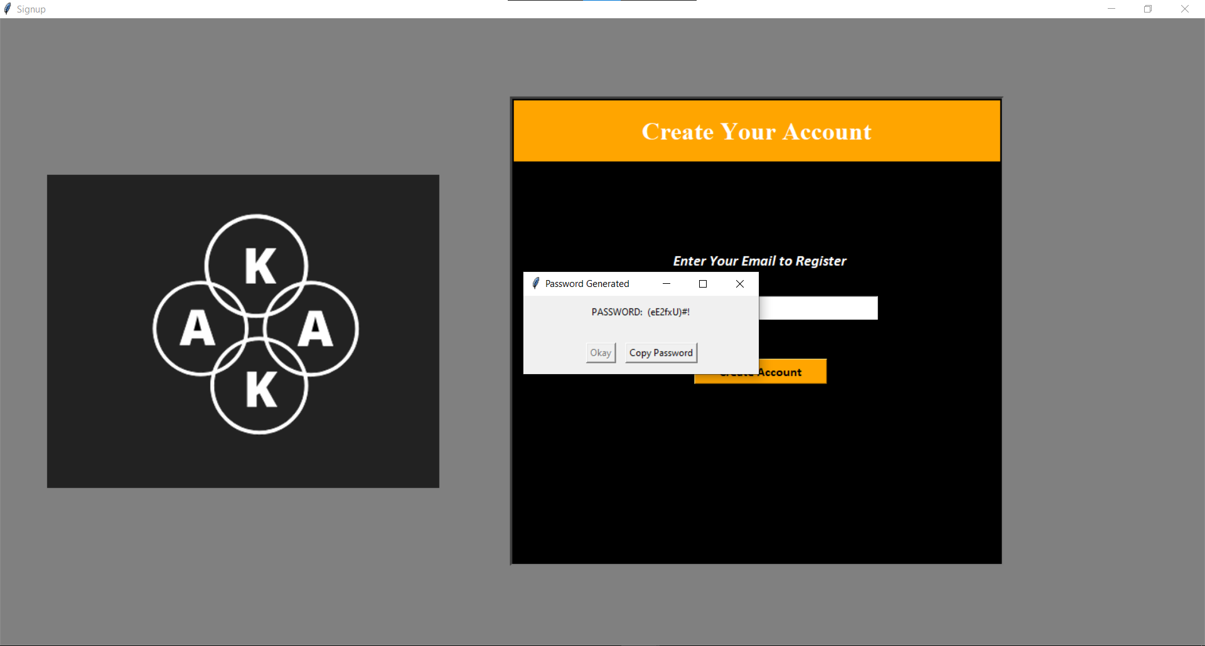
GENERATING RANDOM PASSWORD

Slide 13
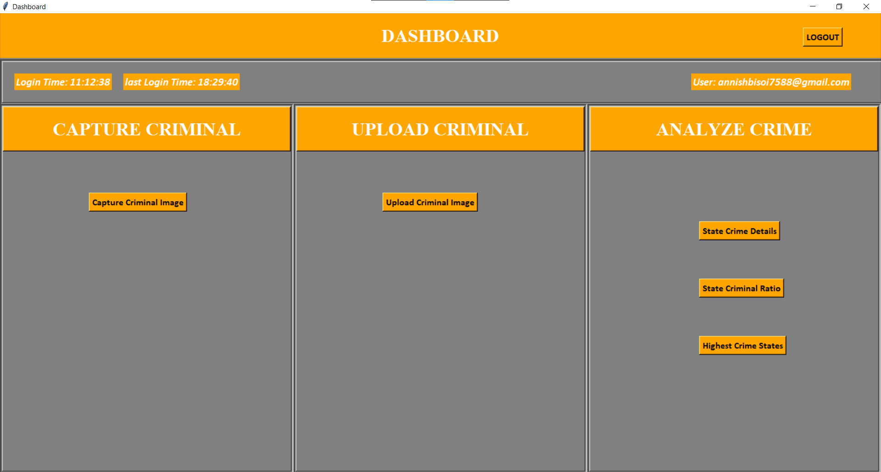
DASHBOARD

Slide 14
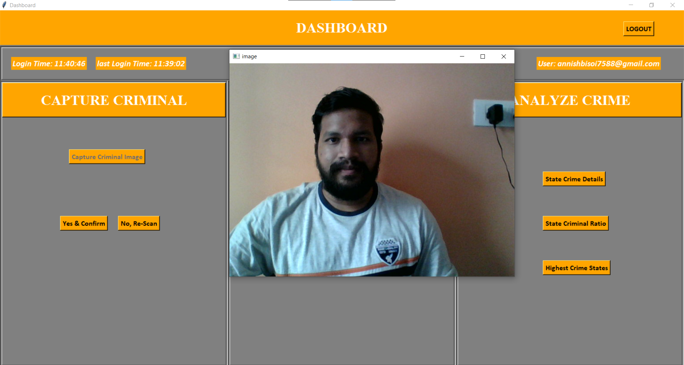
CAPTURE CRIMINAL IMAGE

Slide 15
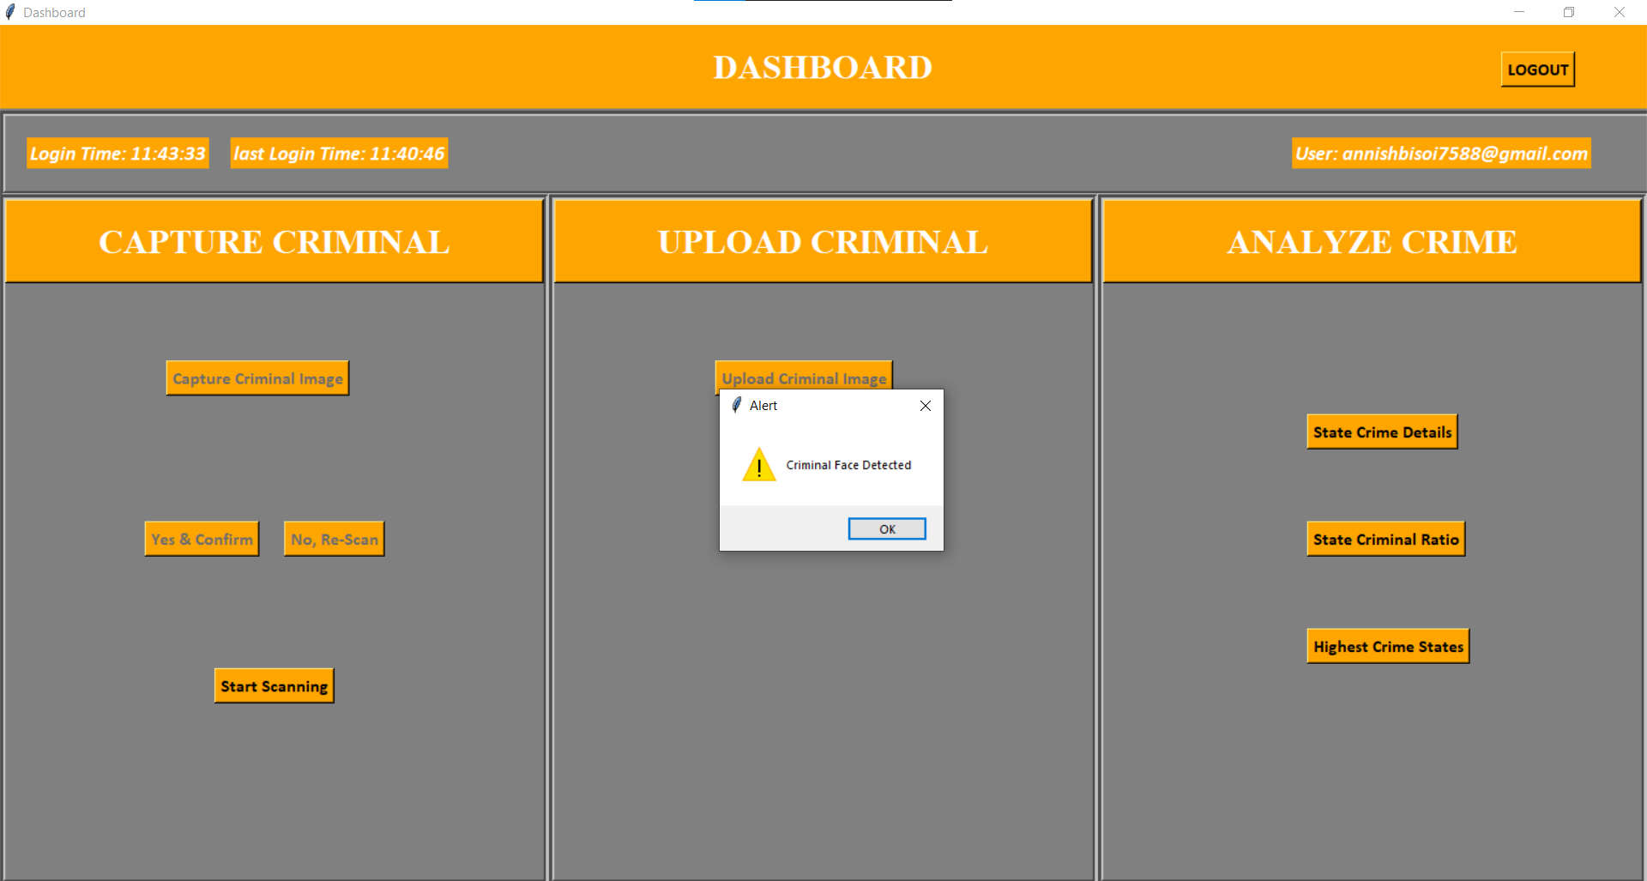
SCAN CRIMINAL IMAGE

Slide 16
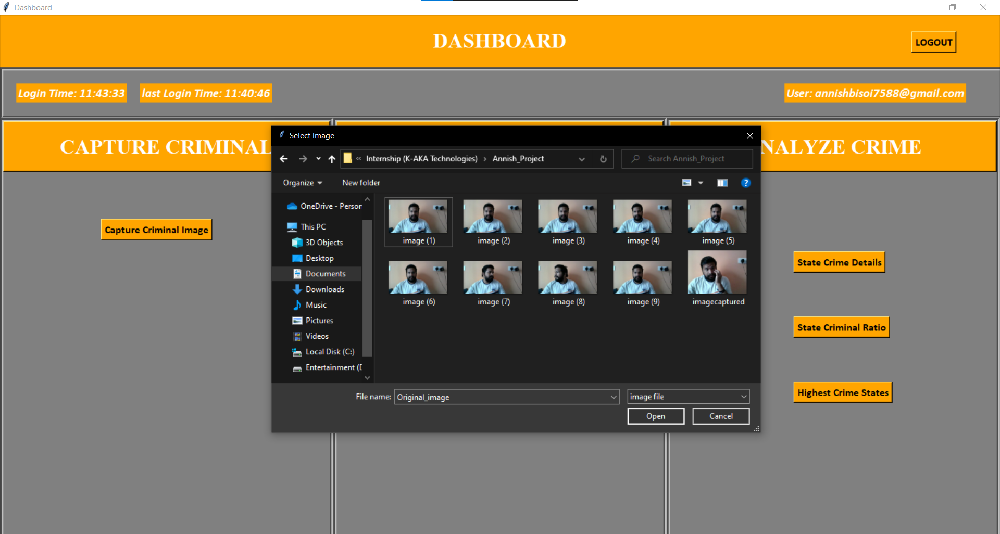
UPLOAD CRIMINAL IMAGE

Slide 17
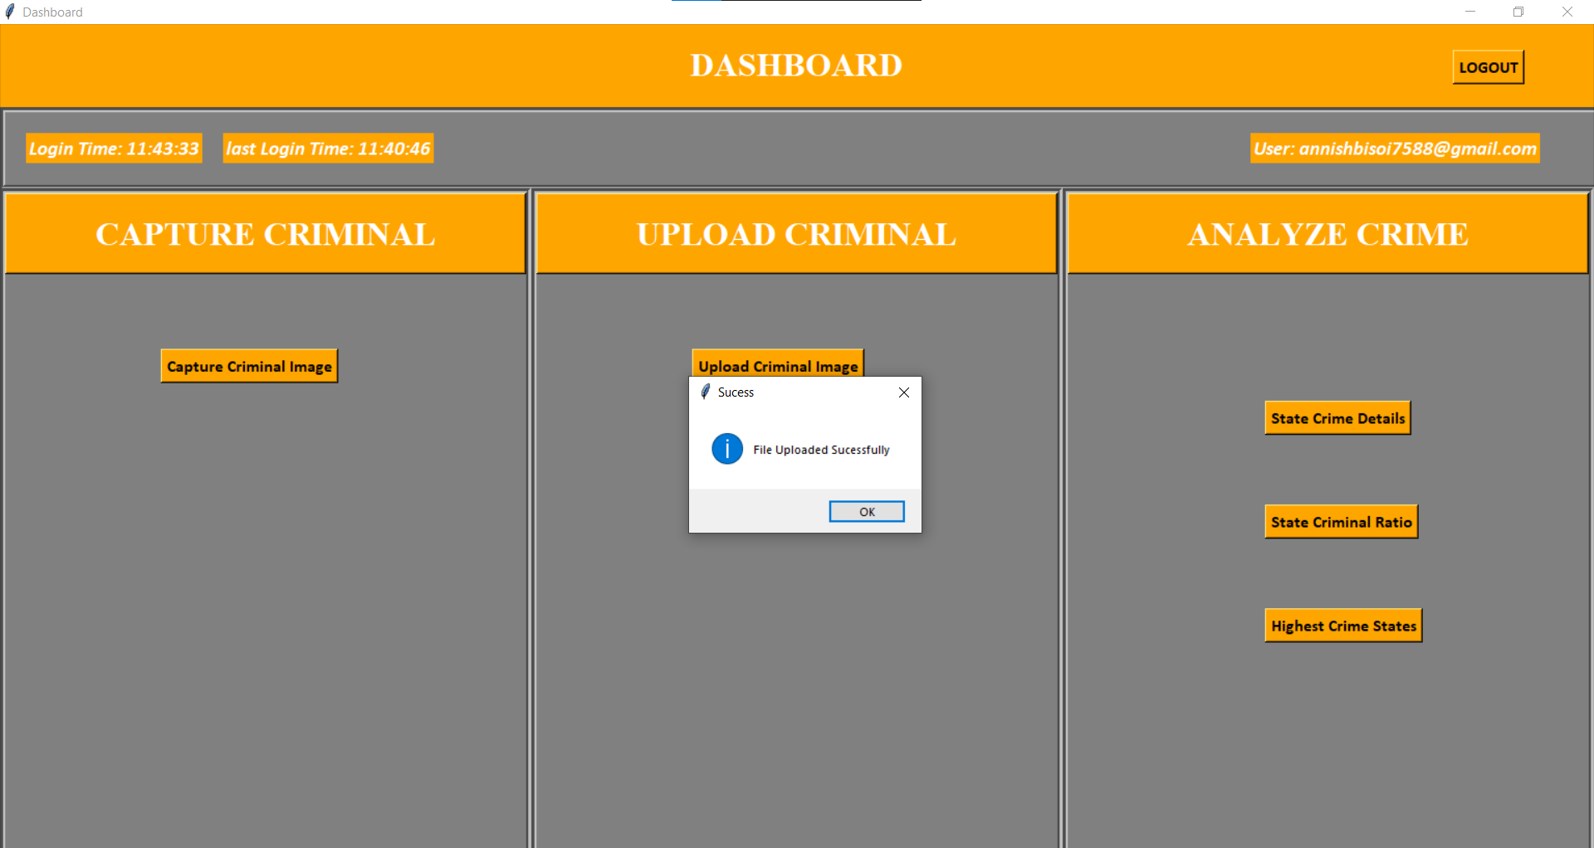
IMAGE UPLOADED SUCCESSFULLY

Slide 18
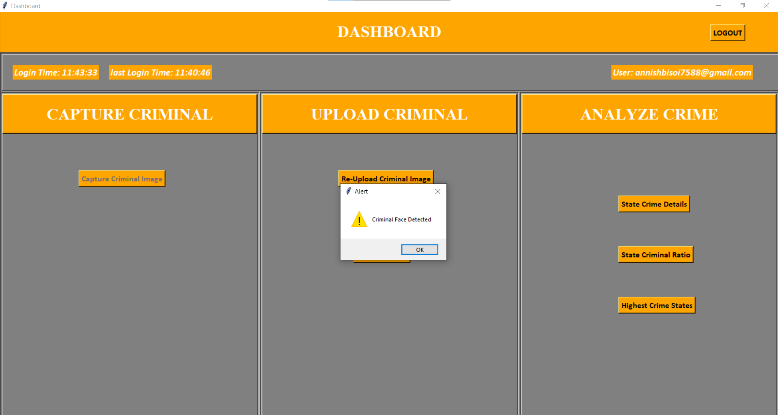
SCAN CRIMINAL IMAGE

Slide 19
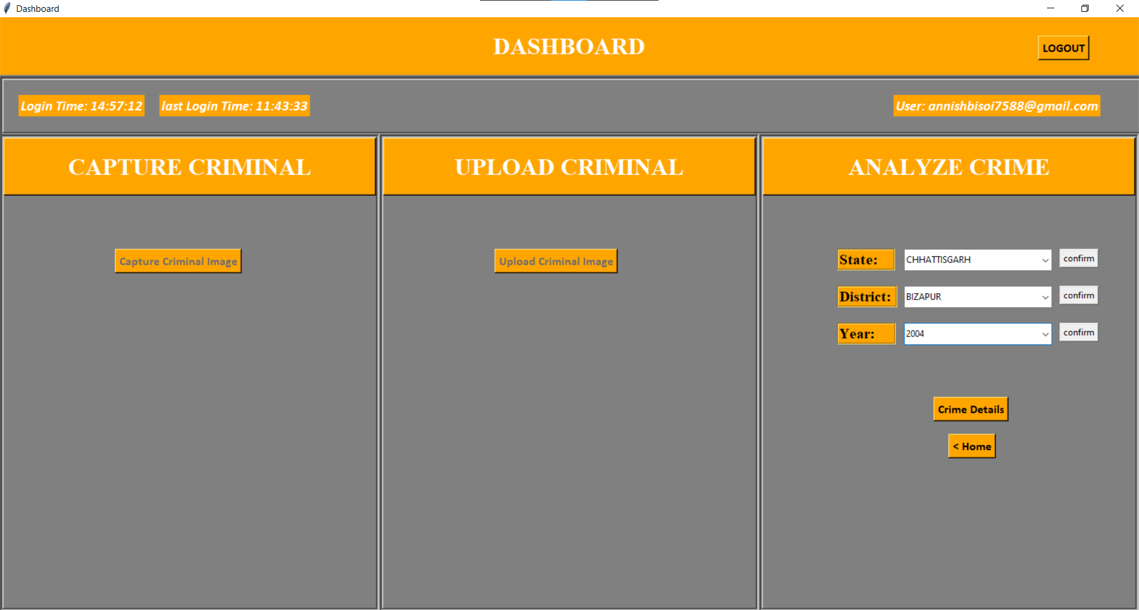
STATE CRIME DETAILS

Slide 20
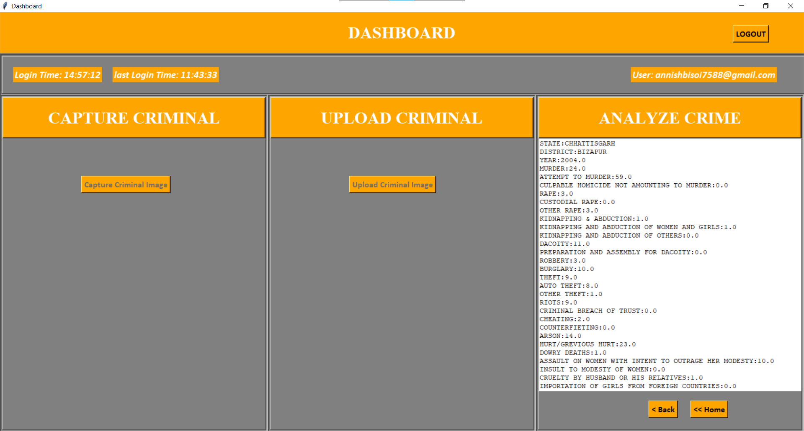
DISPLAYING STATE CRIME DETAILS

Slide 21
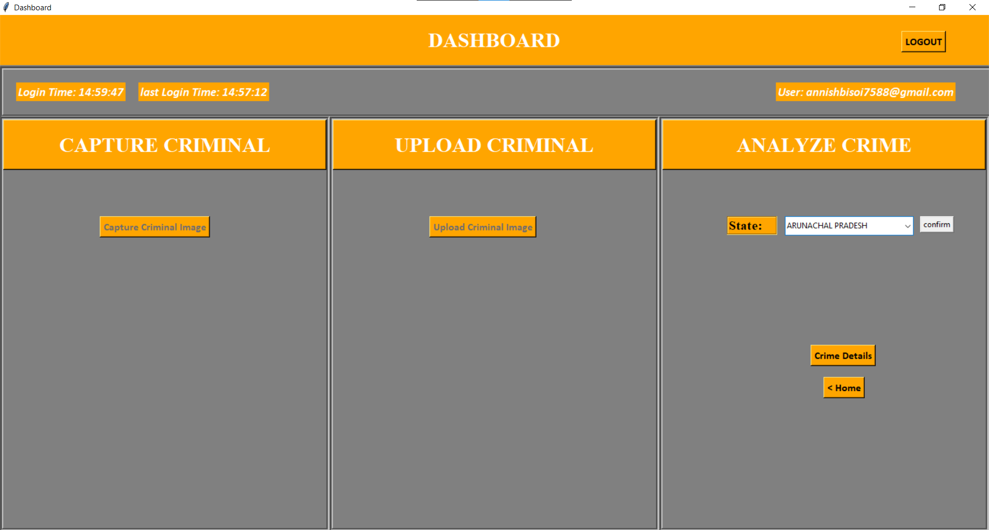
STATE CRIME RATIO

Slide 22
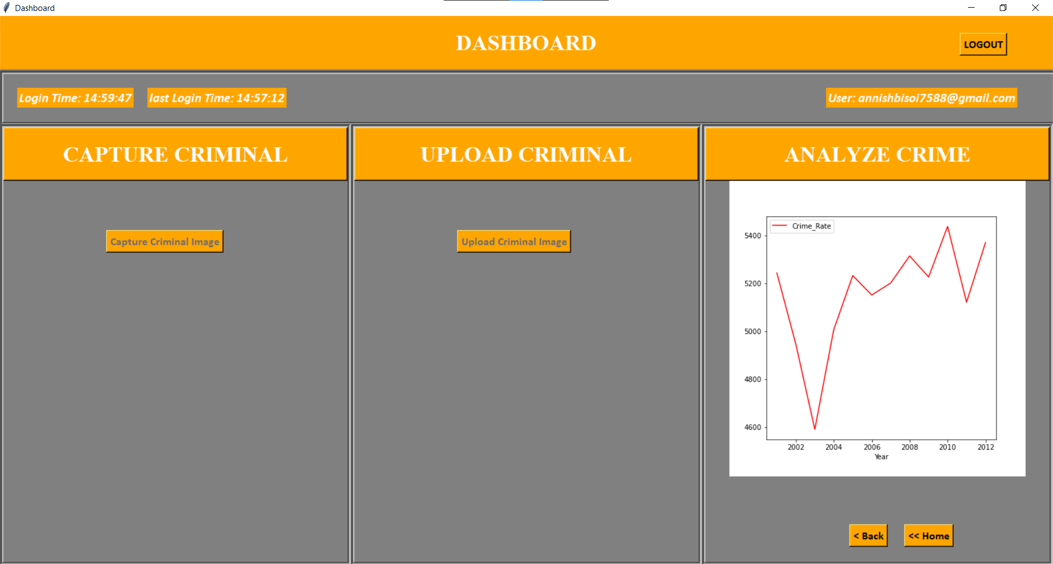
DISPLAYING STATE CRIME RATIO GRAPH

Slide 23
THANK YOU

